Slide 1

Project 1-Used Car Price Analysis
Dhruv Ojha

Slide 2
In the modern world, where pollution is rampant because of the cars and inflation is on the rise, used car market has emerged as a highly competitive market. Pricing always plays crucial role in attracting customers and ensuring profitability of used car dealership, it is essential for us to set the right prices for our cars to gain a competitive edge. To achieve this, we need to understand the factors that influence customer pricing decisions and identify reliable predictors of sale prices.
Motivation:
The goal of our analysis is to investigate the how different features of the car, especially the mileage of used cars serves as a good predictor of their sale prices. By exploring the relationship between these features such as Power of Engine, Size of Engine, Kilometers Driven , Mileage and Prices, we can gain insights into customers' willingness to pay for cars with different features. Additionally, we aim to determine if the slopes and intercepts vary when comparing mileage and price for different car brands. This understanding will enable us to tailor our pricing strategies to specific brands and optimize profitability.
Ultimately, our objective is to set the right prices that not only maximize our profitability but also delight customers, leading to positive feedback and an enhanced reputation in the market.
Through thorough analysis and interpretation of the data, we can provide actionable recommendations to the used car dealership, enabling them to set the right prices and achieve their business objectives. By finding the optimal balance between profitability and customer satisfaction, we aim to position ourselves as one of the key players in the market, driving growth and establishing a strong foothold in the industry.

Slide 3
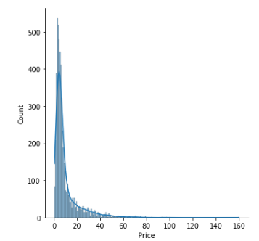
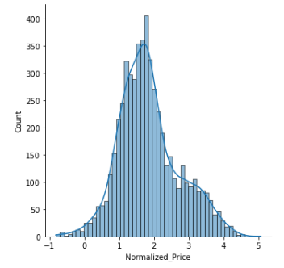
Introduction to Data
The data provided comprises of 7253 rows and 13 columns. This dataset aims to provide the Name of the car, Location of used car, Year of the manufacturing, Kilometers Driven, Type of Fuel and Transmission used, Type of Owner, Mileage, Engine size and its Power, No. of seats, the New Price and the Sale Price of the used car.
Because the dataset is raw data, it had to go through various rounds of data preprocessing, feature engineering and feature scaling. For e.g., missing values were found in columns Mileage, Power, Seats, Price and New_Price. The rows with missing values were dropped but because the New_Price column had more than 6000 values missing, the whole column was dropped. Also, the Column Unnamed: 0 was dropped because of irrelevant data. So, after the first round of preprocessing, we have been left with 5975 rows and 12 columns.
In the next round, the numerical data was extracted from Mileage, Engine and Power columns and the null values in Power and Mileage were replaced by the mean values of the respective columns. Also, the outliers were identified using boxplots and handled accordingly.
Using feature Engineering, the name of the cars from column Name were selected such that only the name of the brand remains, thus creating a new column Brand and dropping the previous column Name.
During univariate analysis of data, it was found that the columns Price, Engine and Power were heavily skewed. So, to normalize the data in order to get more accurate results of regression analysis, log normalization was applied to the respective columns.

Slide 4
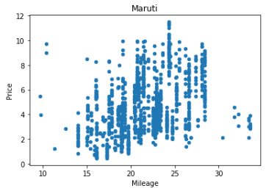
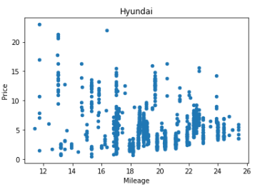
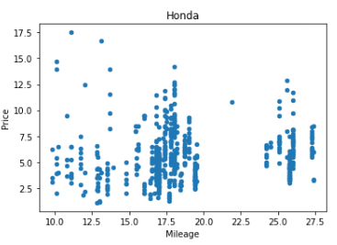
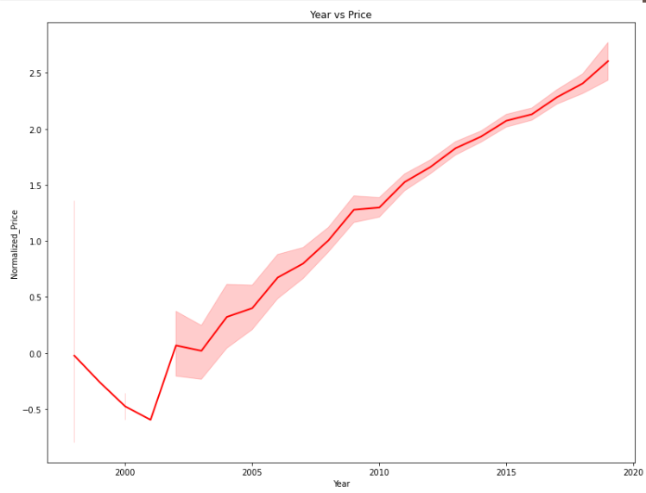
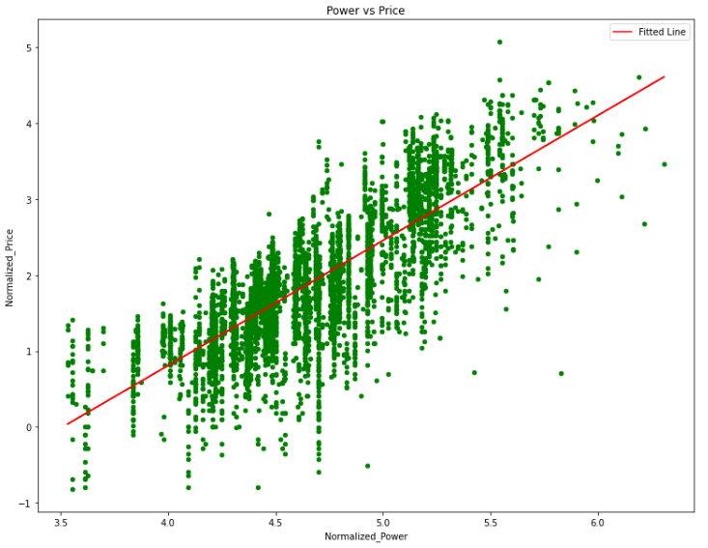
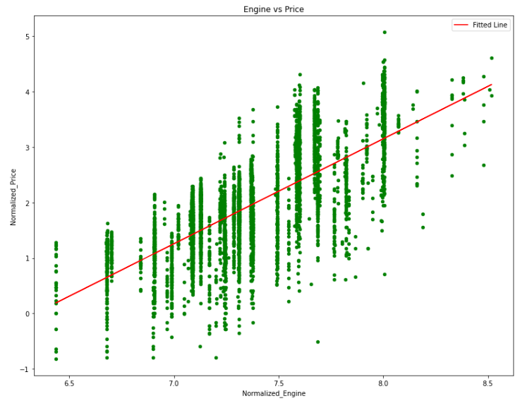
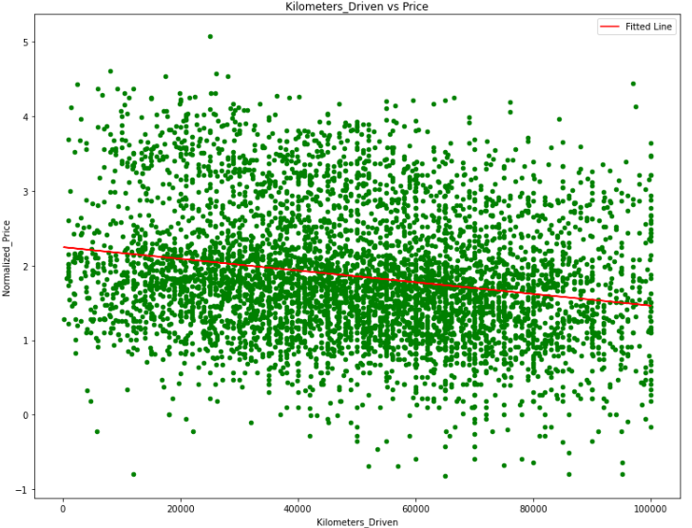
Exploratory Data Analysis (EDA)
EDA was conducted to gain insights into the relationship between mileage and sale prices for each brand of the car. Although outliers were present, maximum of the brands displayed a linear growth in the price of car with more mileage. For e.g. When Maruti’s mileage and price were analysed, a clear linear growth trend was displayed. The same trend was displayed in case of Hyundai, Honda, etc.
Many other visualizations were created like line plots, heatmaps, histograms to determine the trends between Price and other features (bi-variate analysis). These visualizations help us understand if a particular feature will be important will evaluating the price of the cars.

Slide 5
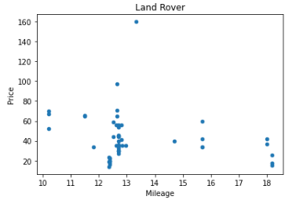
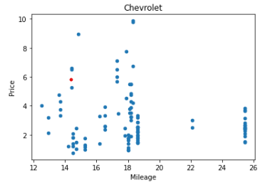
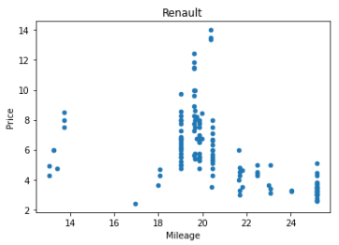
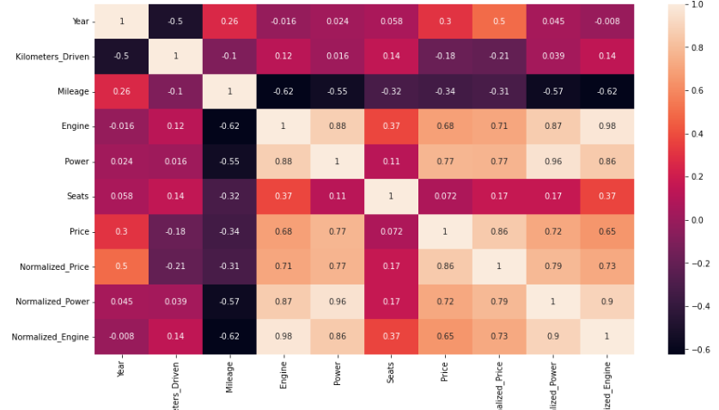
This shows that Engine, Power and year are very important variables in determining the price of a car. So, on the basis of these visualizations, we can conclude that Mileage should not be the only variable in determining the price of a car.
Although most of the brands displayed increase in price with increase in mileage, there are some companies like Land Rover, Renault or Chevrolet that displayed interesting and unique patterns. The reason for this might be that people don’t consider Mileage as a big variable when buying cars of the mentioned brands.
A Heatmap was created to display the correlation between different variables of the dataset. According to the visualization, it is clear that Engine and Power are highly corelated to the Price of the cars thus playing a big role in determining the price of those used cars.

Slide 6
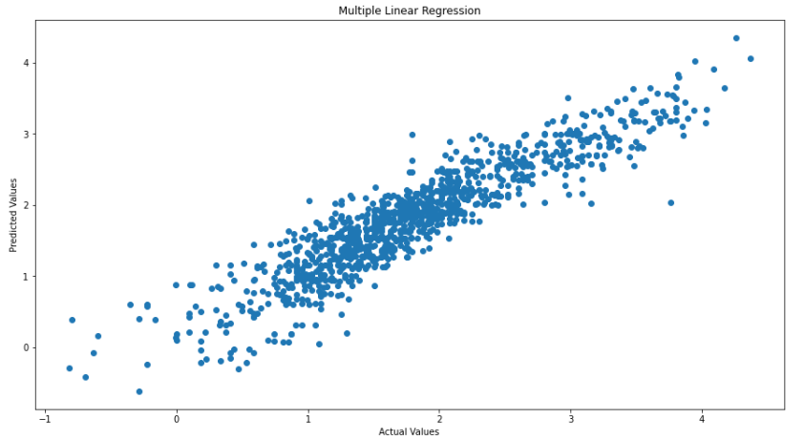
Final Model
We have used Multiple Linear Regression to determine the Price of the used Cars.
Multiple linear regression is a statistical modeling technique used to analyze the relationship between multiple independent variables and a single dependent variable. It extends the concept of simple linear regression, which only considers one independent variable, to incorporate multiple predictors simultaneously. We have used features such as Year, Power and Engine,
Some of the features of Multiple Linear Regression can be Multiple Predictors, Quantitative Relationships, Control of Confounding, Factors Flexibility and Adaptability, etc.
The model was created by importing the necessary libraries, creating 2 data frames x and y with independent and dependent variables, respectively. After that, training and test splits are created.
Then the regression model is fitted to the training data. This involves estimating the coefficients that minimize the sum of squared residuals between the predicted and actual values. The coefficients calculated come out to be all positive, indicating a positive relationship between the variables.
The model is then validated using the testing set. Once the model is validated, it is used to make predictions on new data by plugging in the values of the predictor variables and the visualize the trend.
The model evaluation resulted in good accuracy with R2 score of 84 % , Root Mean Squared Error of 0.34 and Mean Absolute Error of 0.26 .

Slide 7
Interesting Findings
Some of the data columns were heavily skewed. To attain the desired accuracy of the model, feature scaling was used and the columns- Price, Power and Engine were put through Log Normalization to get the right scale for them to be used in the model
Considering the whole dataset, Mileage is not seen as good variable for determining the price of the car. Although some linear trends were seen during the EDA, the coefficient of Mileage and Kilometers_Driven came out to be negative, determining that the variables are negative corelated.
During EDA, it was observed that Power, Engine and Year displayed high collinearity with the Price of the cars.
It was observed that using Normalized version of Power and Engine and using Year as independent variables for determining the Price of used cars (Multiple Linear Regression), generated fairly accurate results (Model Accuracy – 84%) without any overfitting.
Linear trends were visible when Mileage is considered as an Independent variable for Brands such as Maruti, Honda, Hyundai, etc. but mileage in itself cannot be considered a good single variable for price analysis.

Slide 8
Conclusion
The analysis has shown that although mileage seems as a significant predictor of sale prices for used cars for some brands, other factors such as car age, brand, condition, and additional features also play a significant role in determining sale prices. Considering these factors can further refine the pricing strategy and better meet customer preferences.
The multiple linear regression model provides a reliable framework for understanding the relationships between predictor variables and sale prices. It allows for data-driven pricing decisions and improved profitability for the used car dealership.
Future Possibilities
Gathering a more extensive dataset encompassing various car brands, models, and features can enhance the accuracy and robustness of the regression model. By including a larger number of data points, a better understanding of customer preferences can be achieved, leading to improved precision in pricing decisions.
Incorporating market trends and economic factors that influence car prices, such as inflation, fuel prices, and industry-specific events, can enable the pricing strategy to adapt to changing market dynamics. This consideration will ensure that the pricing strategy remains relevant and aligned with the current market conditions.
Actively monitoring customer feedback and reviews can provide valuable insights into their perception of pricing. By analyzing this feedback, the dealership can identify areas for improvement and make adjustments to the pricing strategy accordingly. This customer-centric approach aims to enhance customer satisfaction and generate positive reviews, thus strengthening the dealership's reputation in the market.
By considering these future steps, the used car dealership can continue to refine its pricing strategy, improve customer satisfaction, and establish itself as a prominent player in the market.

